Slide 1




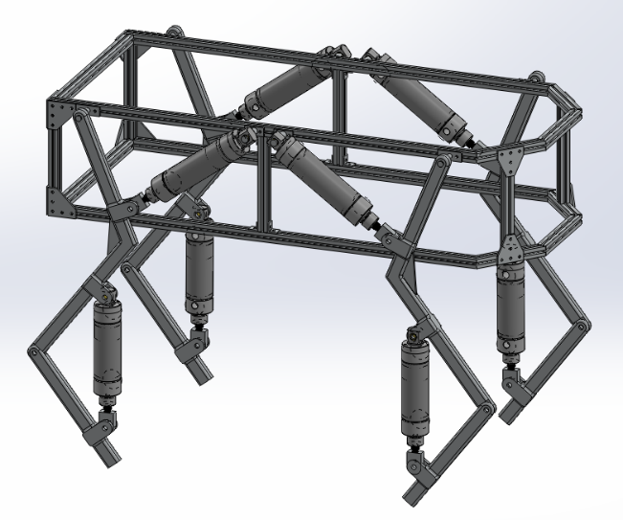
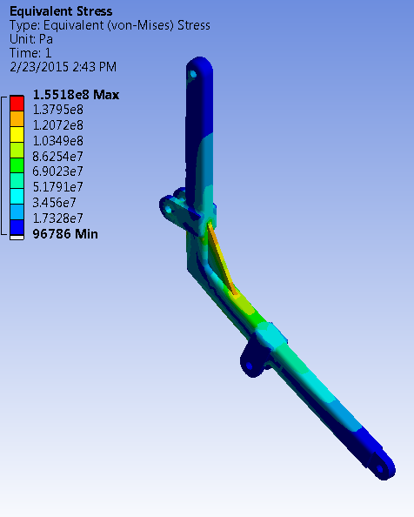
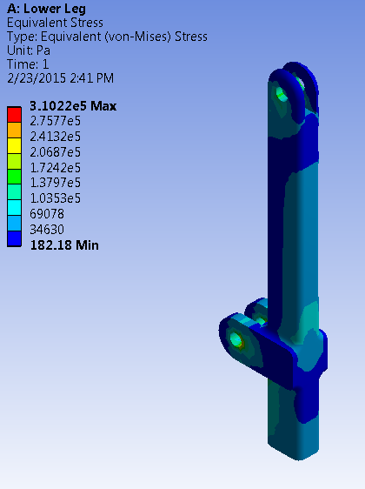
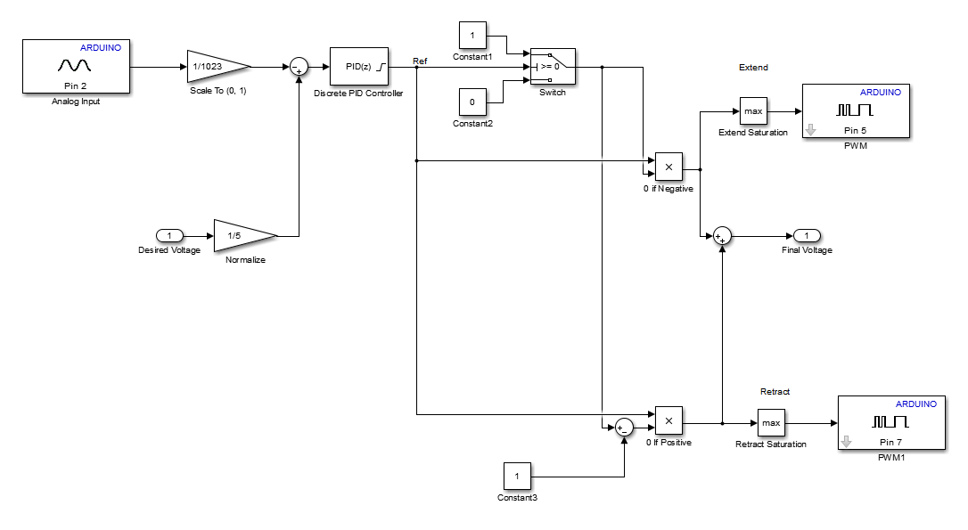
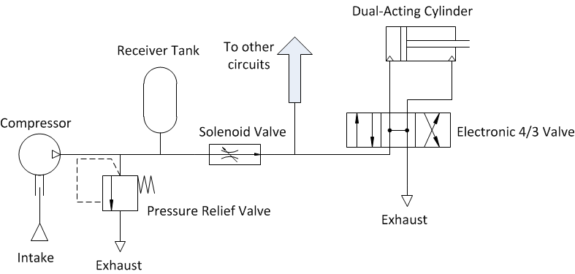
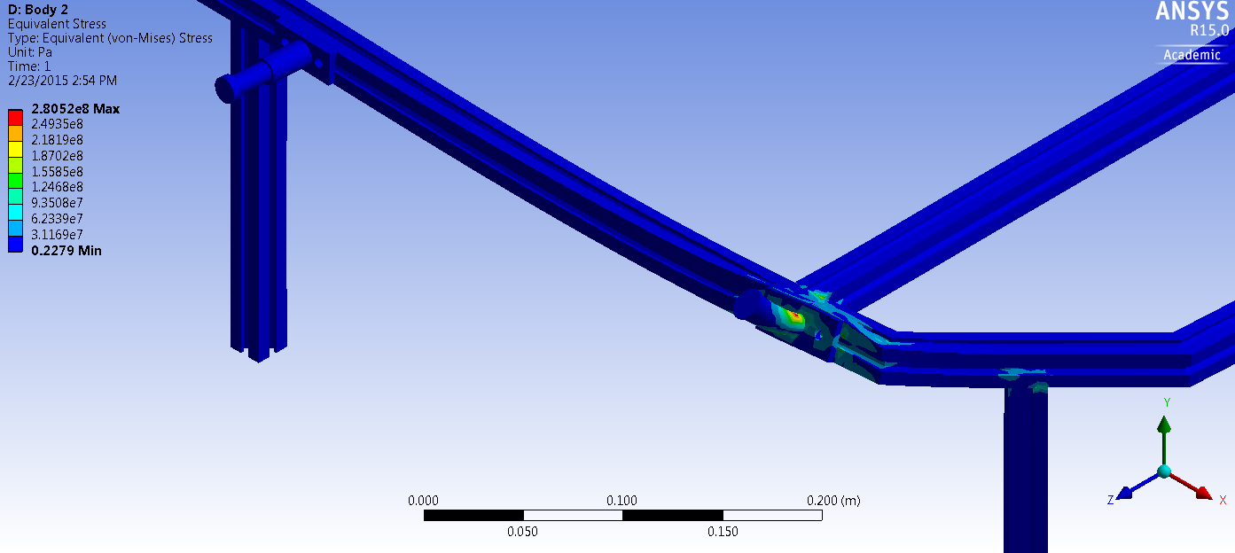
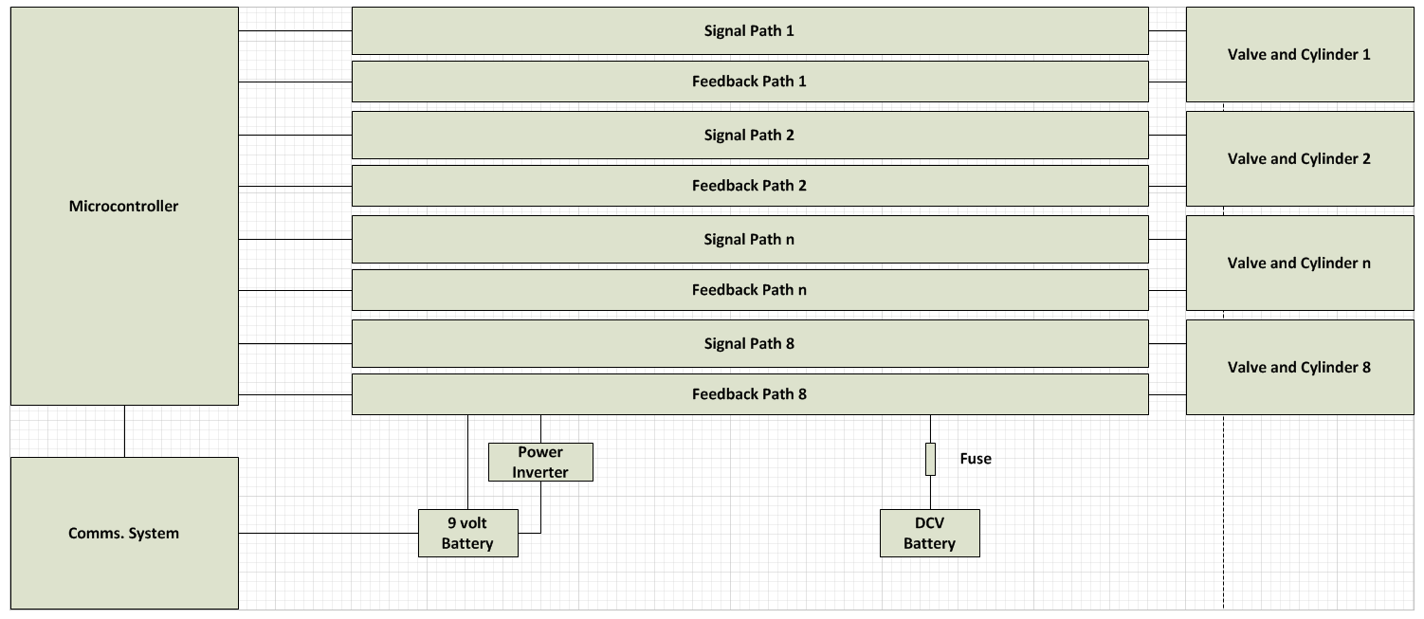
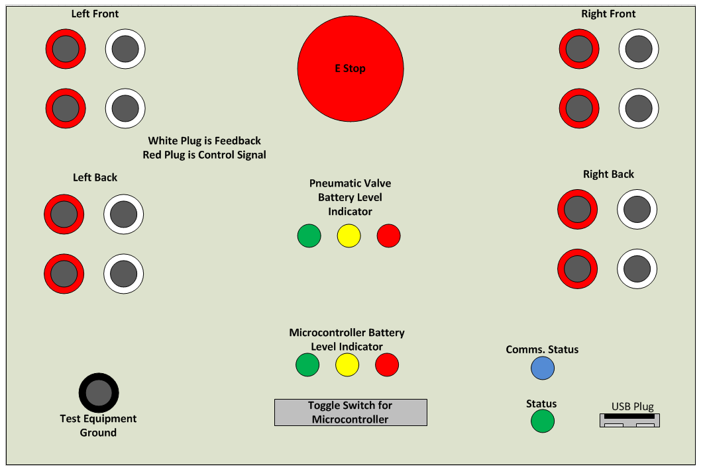
Development of an Agile Educational Robot
Team A.R.C.
Logan Beaver
Justin Campbell
Tyler Paddock
Ronald Shipman
Spring, 2015
Problem Statement
Milwaukee School of Engineering (MSOE) participates in community outreach programs where science, technology, engineering, and mathematics (STEM) topics are demonstrated to encourage younger generations to enter into STEM based degrees and careers. Having an automated control system to demonstrate and interact with would increase the excitement at these outreach programs. Development of a robot with pneumatic locomotion for the Milwaukee School of Engineering’s controls classes would give students a first-hand experience with complex control systems.
Design Constraints/Criteria
A maximum weight of 35 kg for portability
Maximum size of 0.75 m x 0.75 m x 1.0 m box for portability
Custom debug panel creation to facilitate troubleshooting
MATLAB and Simulink model support to allow mechanical engineering students to update control algorithms without knowledge of C/C++
Electronic fuses and shielding to protect the robot and operator during use and maintenance
Mechanical protection to reduce the risk of pinching and self-collision damage to the robot
An easy to access emergency stop to quickly depower the robot
A pressure relief valve to reduce the risk of overloading and damaging pneumatic components
User Control
User input is read by a USB controller
Real time Java application parses user input
Application sends commands through an Xbee wireless chip
Partner Xbee chip receives the command and sends it to the Arduino
Arduino decodes the serial command and adjusts the robot state accordingly
Arduino Mega 2560
Mechanical Design
Chassis Construction
6105-T5 T-Slotted Aluminum Framing (Yield Strength = 275 Mpa)
6061 Aluminum Plate (Yield Strength = 276 Mpa)
Leg Construction
6061 Aluminum Bar (Yield Strength = 276 Mpa)
XBee
XBee
Pneumatic Design
Using pneumatic systems as the driving force for the legs, the following components will be utilized:
Double-acting, air cylinders with position feedback sensors (1.5 in. bore diameter)
Two-solenoid 4 way 3 position directional control valves (0.37 C_{v})
Air-compressor
Pressure relief valve
Soft start/dump solenoid valve
Secondary receiver tank
High Level System Communication Diagram
Control System
Mathworks Simulink model is loaded onto the Arduino
Utilizes PID feedback loops to control cylinder lengths
Desired length is calculated by a state machine based on user input and current length
PID Control subsystem for a single cylinder
Electrical Design
Acknowledgements
Special thanks to Joy Global, Inc., the National Fluid Power Association, Emerson and Dr. Luis A. Rodriguez for their support

